Slide 1
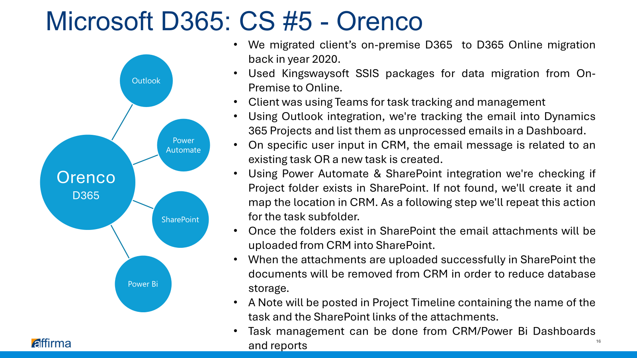

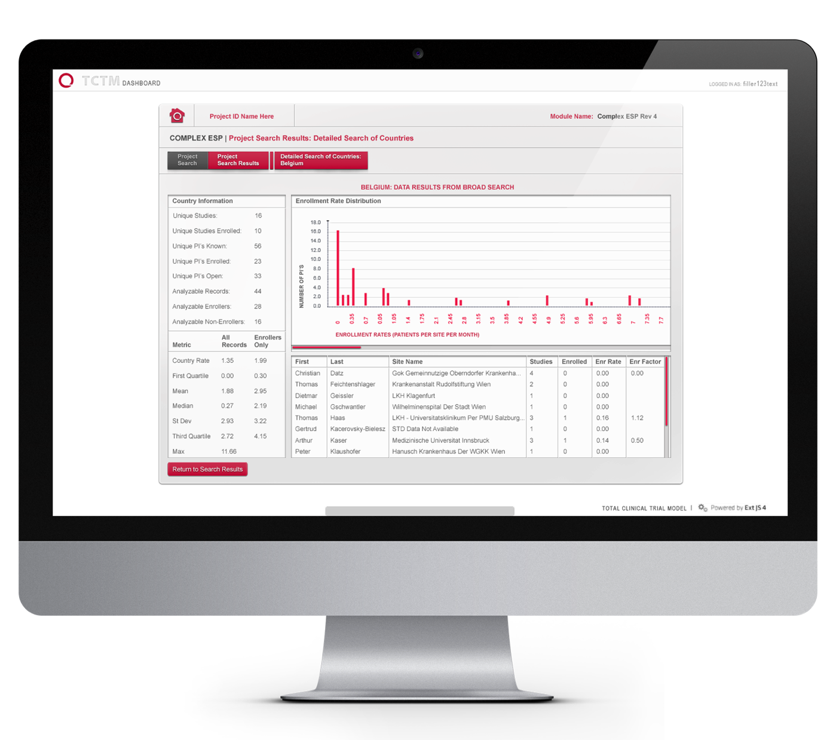
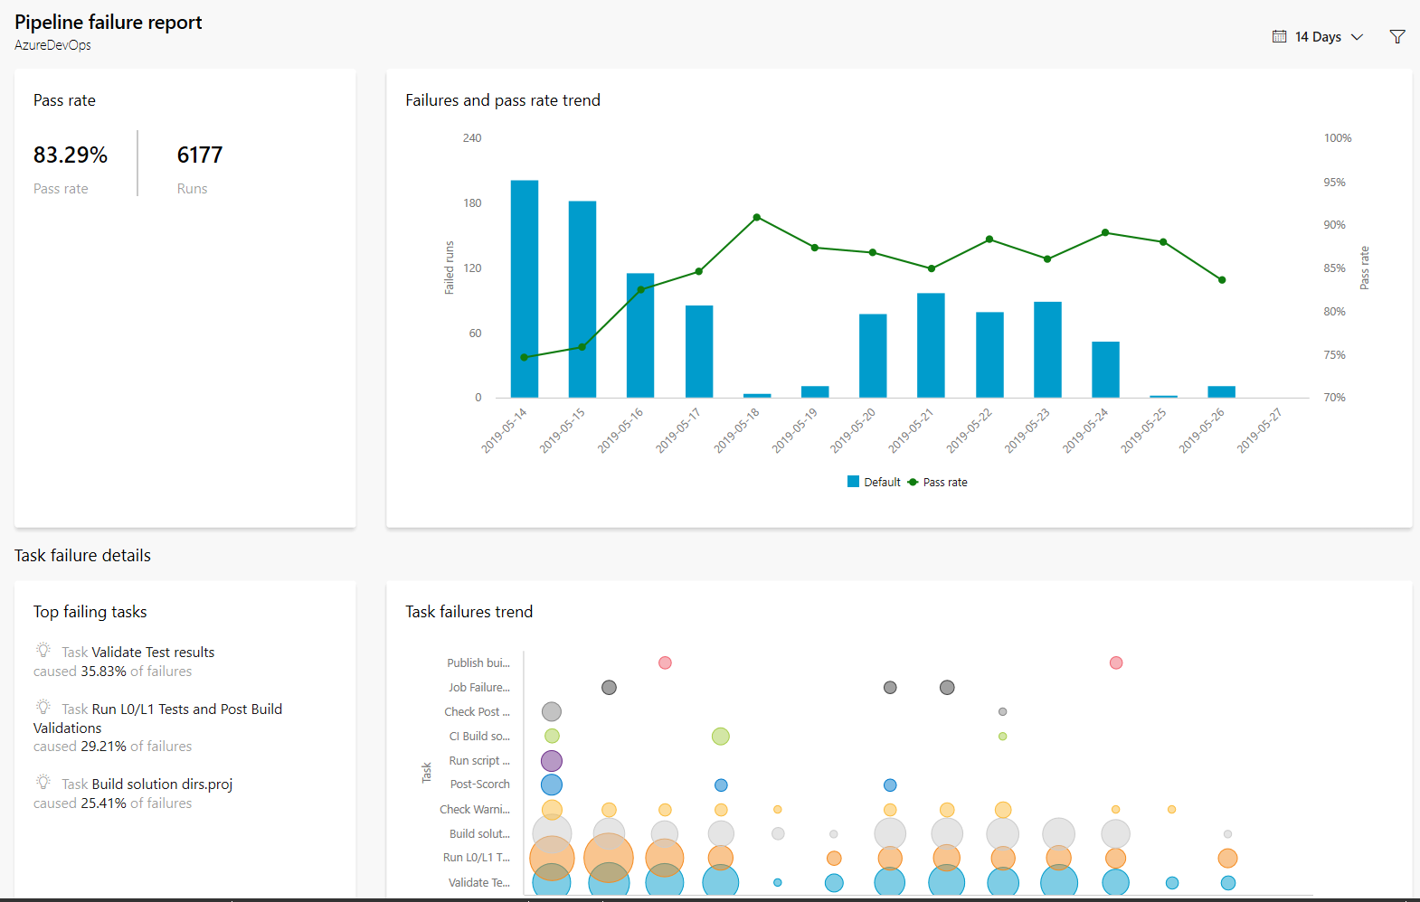
Alaska National Insurance TFS to ADO Migration
Business Need
Alaska National Insurance Company (ANIC) was using an outdated on-premise Team Foundation Service (TFS) instance for source control and project management of over 50 projects.
ANIC required assistance with migrating TFS to Azure DevOps and implementing best practice process for deployment process and task management.
What We Did
Setup Azure DevOps and decommissioned on-premise TFS service
Migrated existing code repositories and project tasks from TFS to Azure DevOps
Setup new build and release pipelines for existing code bases
Documented and trained best practices for DevOps to ANIC software developers

